Slide 1
the Canadian Chamber of Commerce in Latvia (CanCham)

Slide 2
Established 1999 5 months old

Slide 3
Main Tool
Cluster

Slide 4
Customer’s requirement
THE
CLUSTER
solution for the customer ☺

Slide 5
Key Points
1+1=3+
How we can earn money in the end of day

Slide 6
Networking Levels
amongst members,
with member networks and other chambers and professional organizations/associations,
with Canadian counterparts,
with counterparts in other countries that are linked to our members.

Slide 7
What we will do together:
present our products/services,
discuss how we will promote our products/services with each others involvement,
use work groups of related products/services to develop strategies,

Slide 8
An important vehicle The CanCham Web site

Slide 11
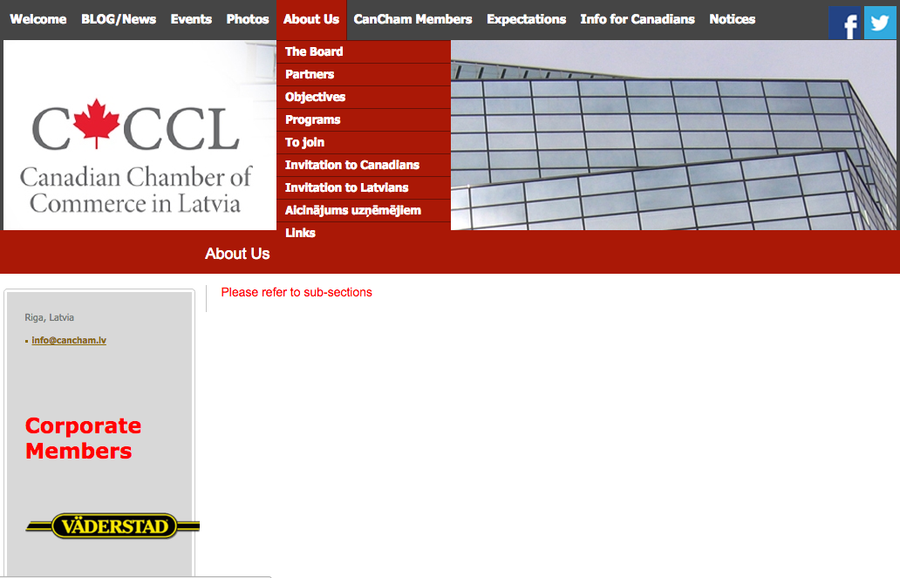

Slide 12
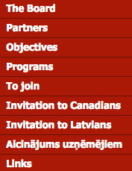

Slide 14
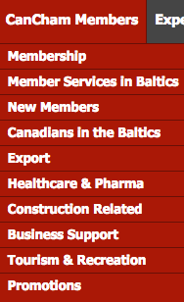

Slide 15
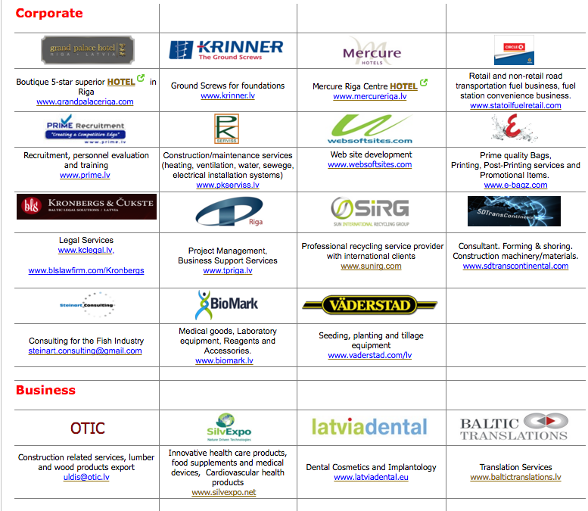

Slide 18
The Canadian Chamber of Commerce in Latvia
welcomes
active participants

