Slide 1
CanCham Christmas supporting “Nāc līdzās!”

Slide 3
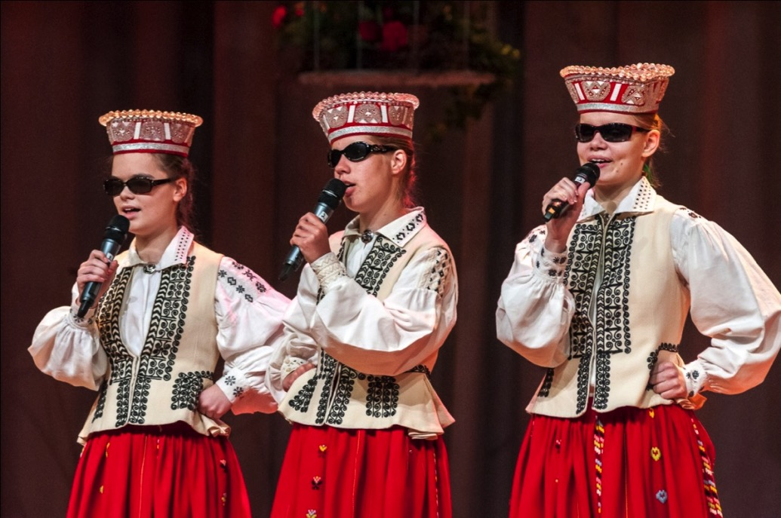
CanCham Christmas supporting “Nāc līdzās!
CanCham Christmas supporting
http://www.naclidzas.lv/en/about-us

Slide 4
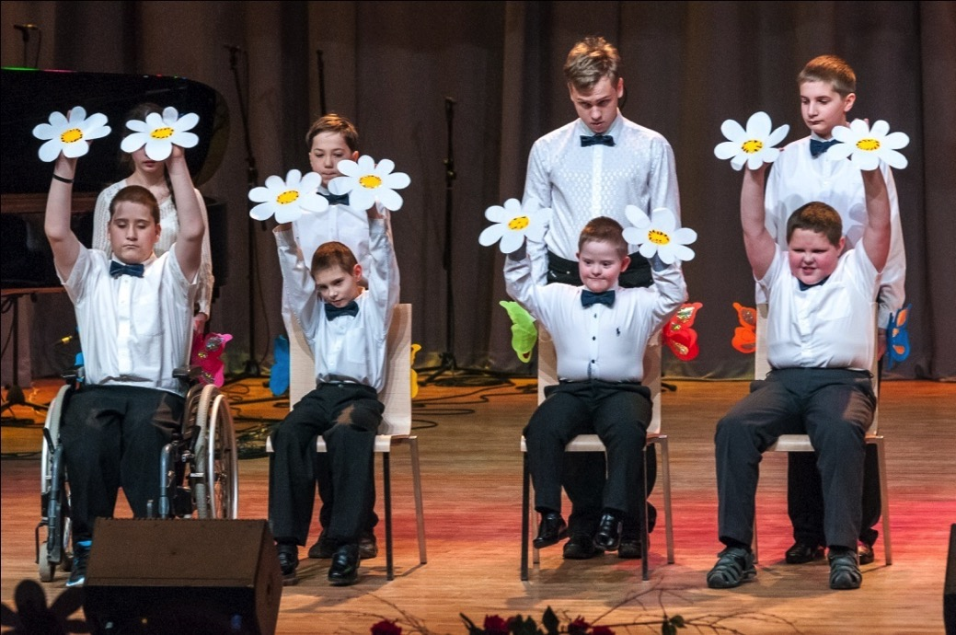
CanCham Christmas supporting “Nāc līdzās!
CanCham Christmas supporting

Slide 5
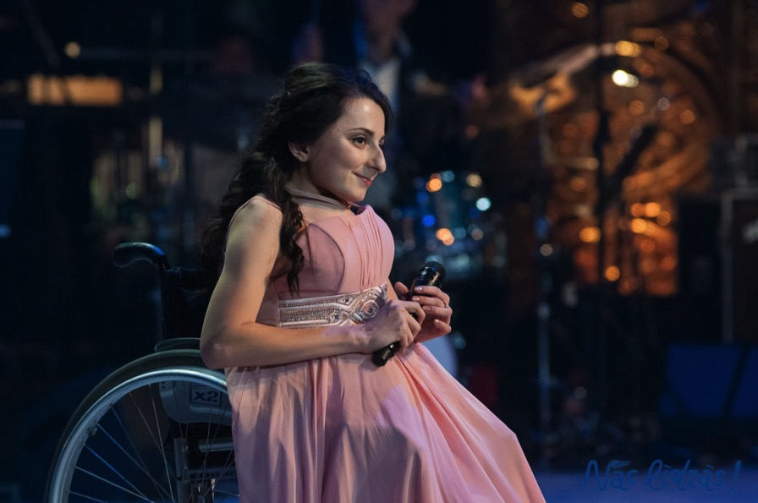
CanCham Christmas supporting “Nāc līdzās!
CanCham Christmas supporting
Diana Ponaskova. Daumants Kalnins.
HAVE YOURSELF A MERRY LITTLE CHRISTMAS

Slide 6
CanCham Christmas supporting “Nāc līdzās!
CanCham Christmas supporting

Slide 7
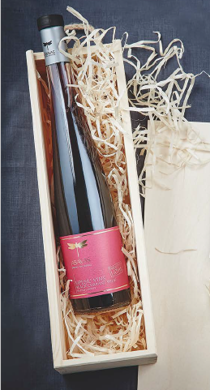
CanCham Christmas supporting “Nāc līdzās!
CanCham Christmas supporting

Slide 8
Circle K GLOBAL AND LOCAL
CanCham Christmas supporting

Slide 9
200 Pastries
100l Fuel
52 L-size Hot drinks
52 Hot Dogs
44 XL-size Hot drinks
35 Burgers
10 Carwashes

Slide 10
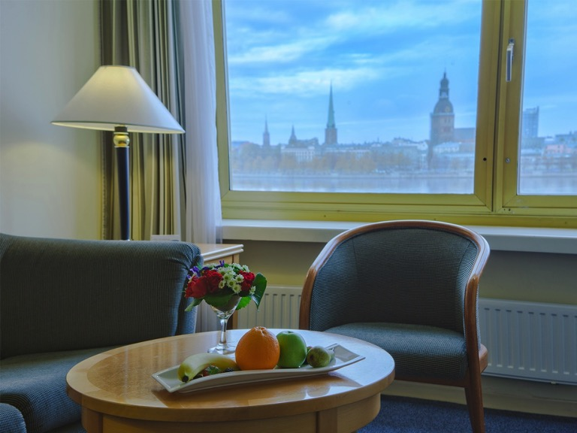
CanCham Christmas supporting “Nāc līdzās!
CanCham Christmas supporting
Business class stay-over

Slide 11
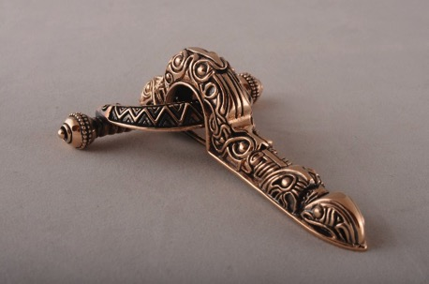
CanCham Christmas supporting “Nāc līdzās!
CanCham Christmas supporting
1st Voucher: 50 eiro
For any purchase - www.kalupesrotas.lv/shoppe
2nd Voucher: 50 eiro
Towards any custom designed piece of jewellery

Slide 12
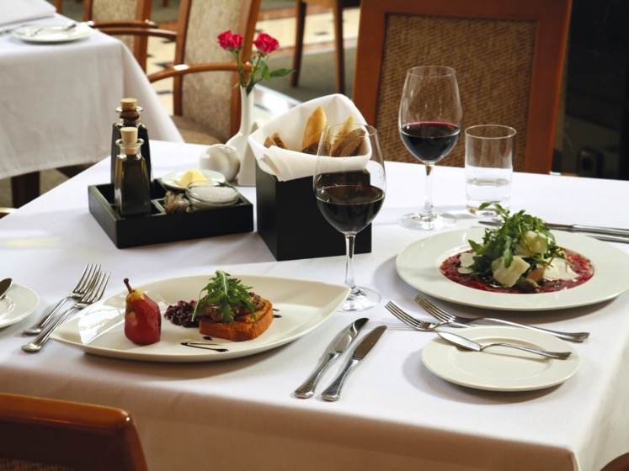
CanCham Christmas supporting “Nāc līdzās!
CanCham Christmas supporting
Dinner at Radisson Blu Hotel Rīdzene restaurant Piramida 50.00 EUR

Slide 13
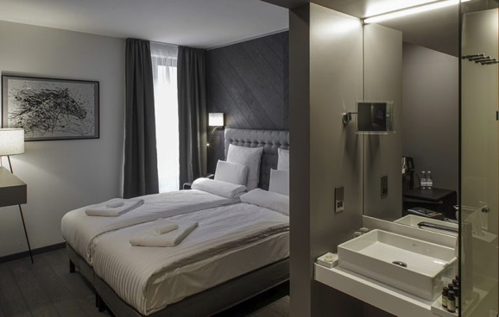
CanCham Christmas supporting “Nāc līdzās!
CanCham Christmas supporting
Overnight for two people
in Pullman Riga Old Town Hotel

Slide 14
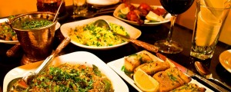
CanCham Christmas supporting “Nāc līdzās!
CanCham Christmas supporting
Dinner at the Indian Raja Restaurant 25.00 EUR

Slide 15
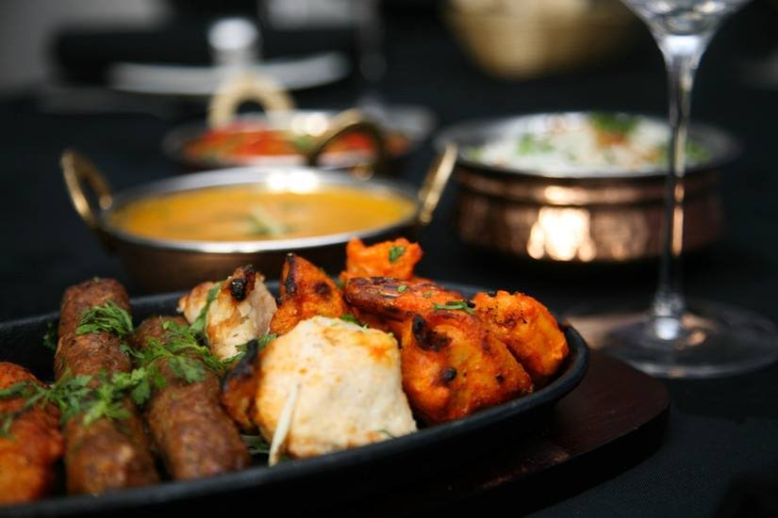
CanCham Christmas supporting “Nāc līdzās!
CanCham Christmas supporting
Gift card 50 EUR dinner

Slide 16
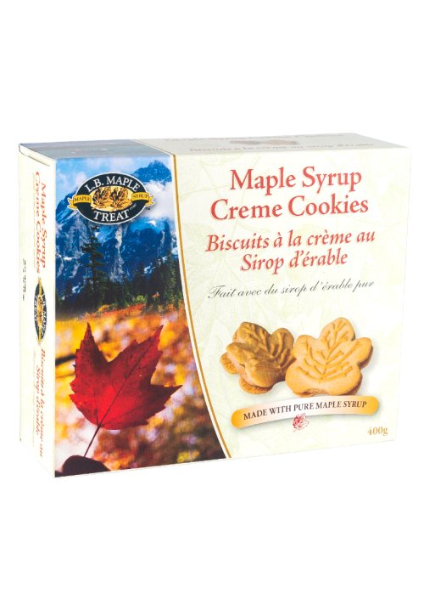
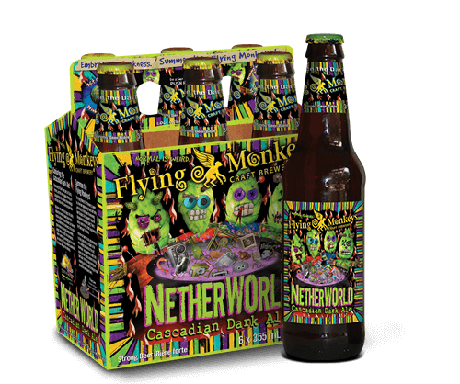
CanCham Christmas supporting “Nāc līdzās!
CanCham Christmas supporting

Slide 17
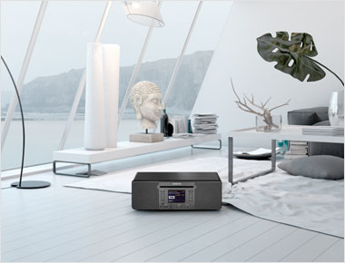
CanCham Christmas supporting “Nāc līdzās!
CanCham Christmas supporting

Slide 18
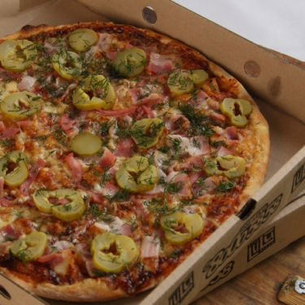
CanCham Christmas supporting “Nāc līdzās!
CanCham Christmas supporting

Slide 19
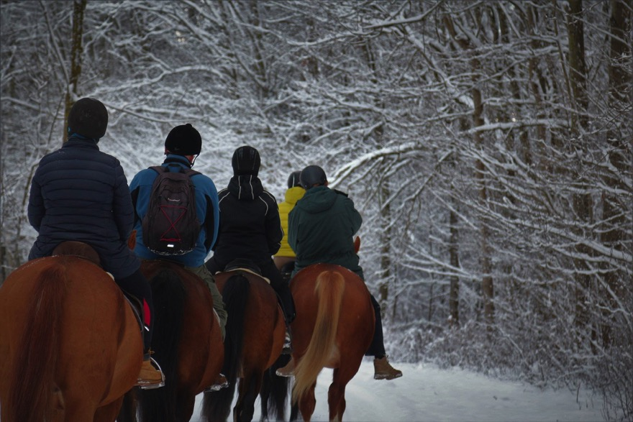
CanCham Christmas supporting “Nāc līdzās!
CanCham Christmas supporting

Slide 20
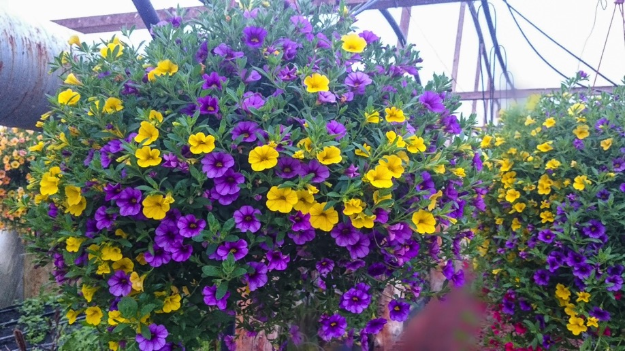
CanCham Christmas supporting “Nāc līdzās!
CanCham Christmas supporting

Slide 21
CanCham Christmas supporting “Nāc līdzās!
CanCham Christmas supporting

Slide 22
CanCham Christmas supporting “Nāc līdzās!
CanCham Christmas supporting “Nāc līdzās!
CanCham Christmas supporting
2 h Amber Crystal Treatment

Slide 23
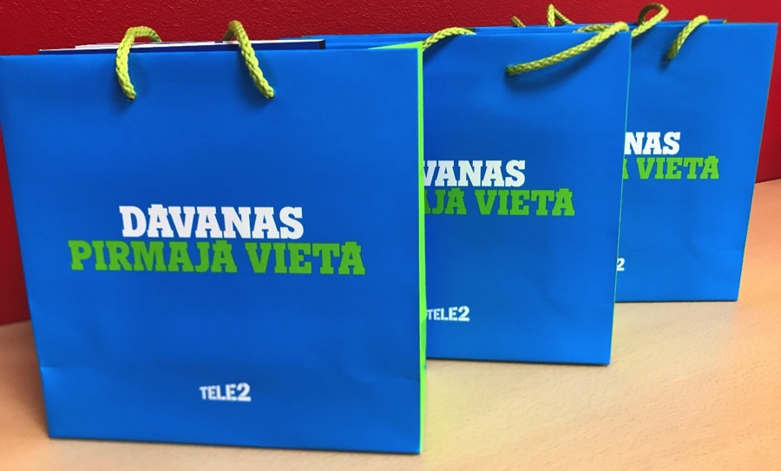
CanCham Christmas supporting “Nāc līdzās!
CanCham Christmas supporting

Slide 24
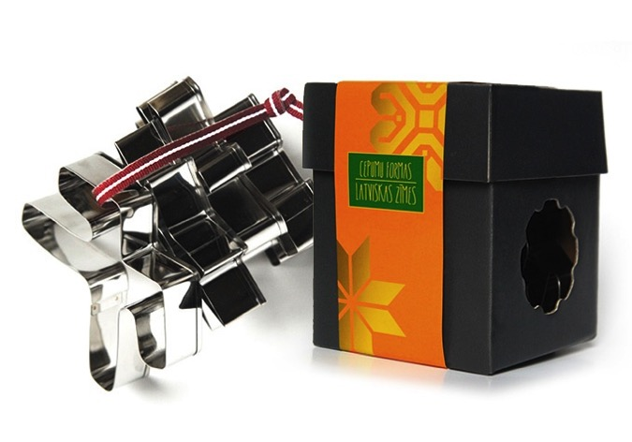
CanCham Christmas supporting “Nāc līdzās!
CanCham Christmas supporting

Slide 25
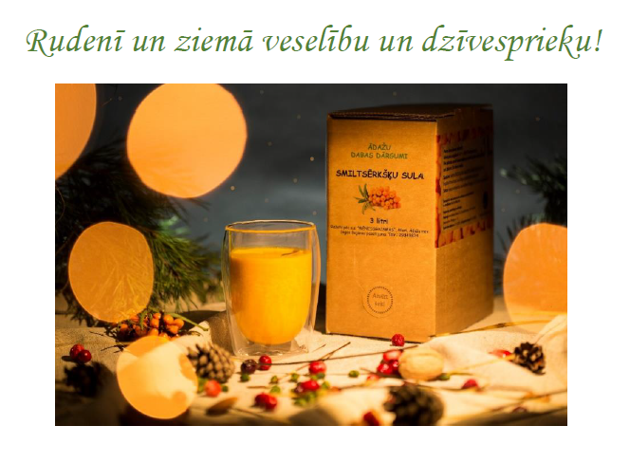
CanCham Christmas supporting “Nāc līdzās!
CanCham Christmas supporting
Inga un Gundars Bojāri

Slide 26
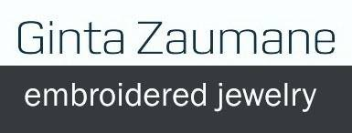
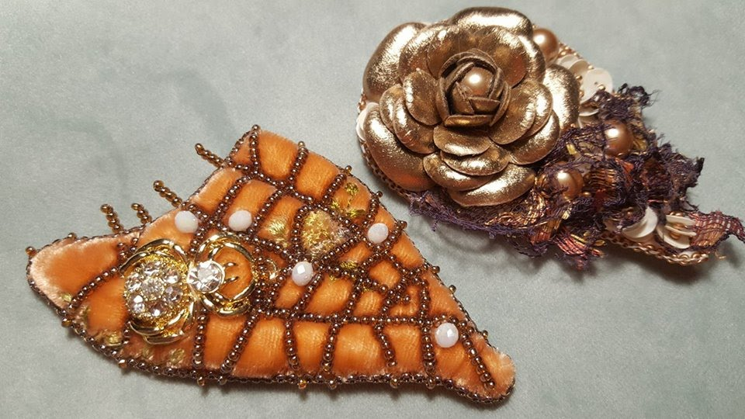
CanCham Christmas supporting “Nāc līdzās!
CanCham Christmas supporting

Slide 27
CanCham Christmas supporting “Nāc līdzās!
CanCham Christmas supporting

Slide 28
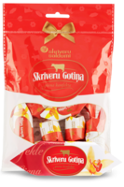
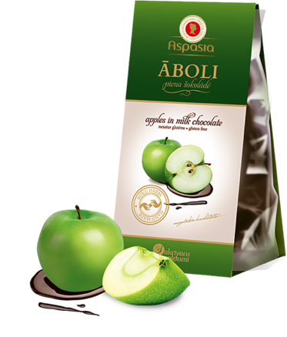
CanCham Christmas supporting “Nāc līdzās!
CanCham Christmas supporting

Slide 29
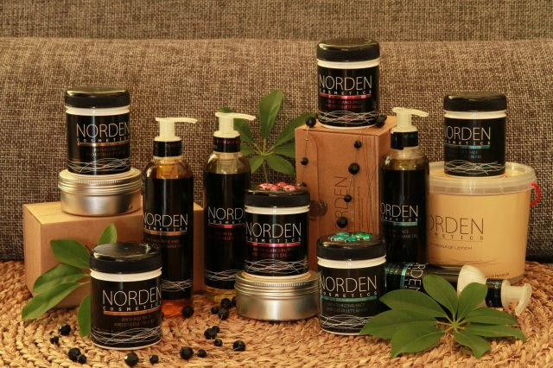
CanCham Christmas supporting “Nāc līdzās!
CanCham Christmas supporting

Slide 30
CanCham Christmas supporting “Nāc līdzās!
v
CanCham Christmas supporting

Slide 31
CanCham Christmas supporting “Nāc līdzās!
CanCham Christmas supporting

Slide 32
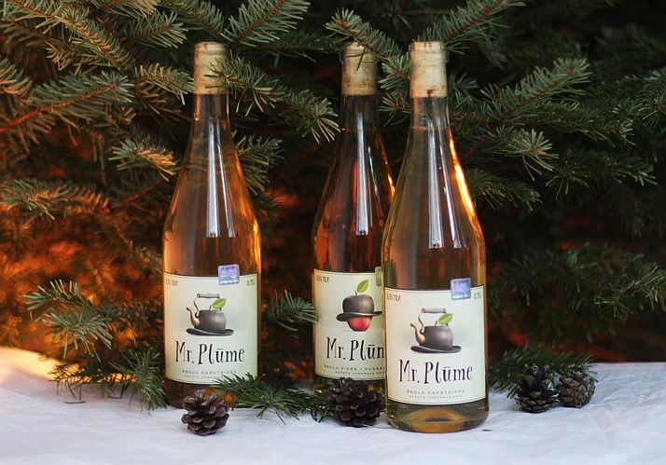
CanCham Christmas supporting “Nāc līdzās!
CanCham Christmas supporting

Slide 33
CanCham Christmas supporting “Nāc līdzās!
CanCham Christmas supporting

Slide 34
CanCham Christmas supporting “Nāc līdzās!
CanCham Christmas supporting

Slide 35
CanCham Christmas supporting “Nāc līdzās!
CanCham Christmas supporting
Normunds Medens
Christmas Bigbend Concert
2 invitations

Slide 36
CanCham Christmas supporting “Nāc līdzās!
CanCham Christmas supporting
Swedish lesson
1 academic hour's introduction

Slide 37
CanCham Christmas supporting “Nāc līdzās!
CanCham Christmas supporting

Slide 38
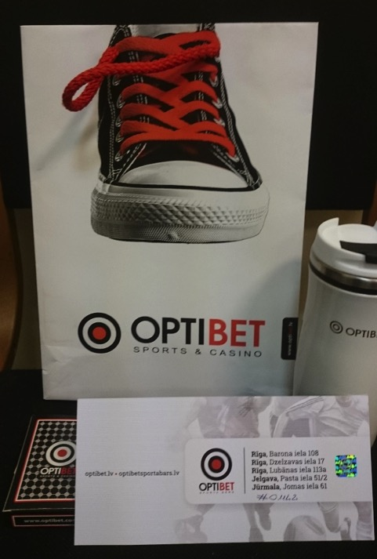
CanCham Christmas supporting “Nāc līdzās!
CanCham Christmas supporting

Slide 39
CanCham Christmas supporting “Nāc līdzās!
CanCham Christmas supporting

Slide 40
CanCham Christmas supporting “Nāc līdzās!
CanCham Christmas supporting

Slide 41
CanCham Christmas supporting “Nāc līdzās!
CanCham Christmas supporting

Slide 42
CanCham Christmas supporting “Nāc līdzās!
CanCham Christmas supporting

Slide 43
CanCham Christmas supporting “Nāc līdzās!
CanCham Christmas supporting
Event sponsorship from
Sam Davidovich

